Slide 1

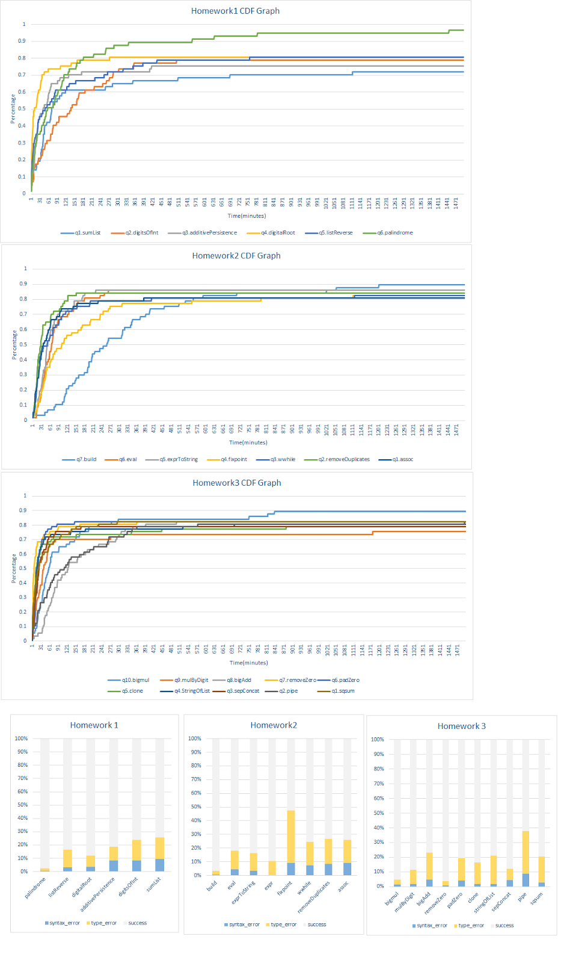
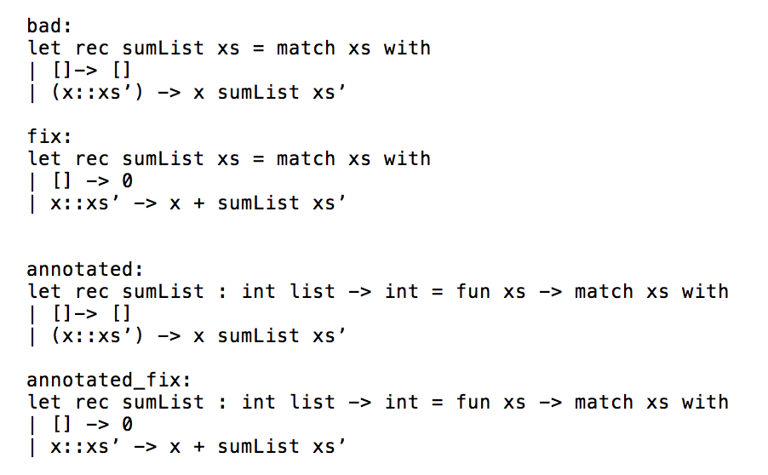
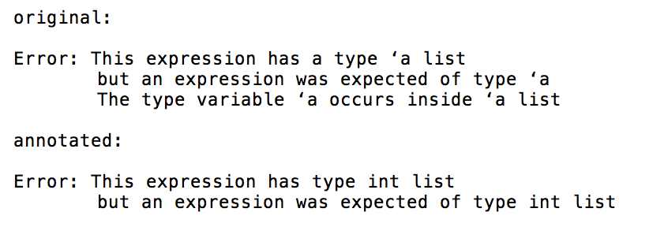
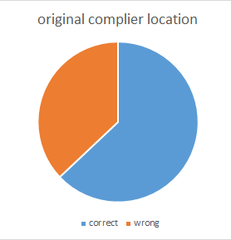
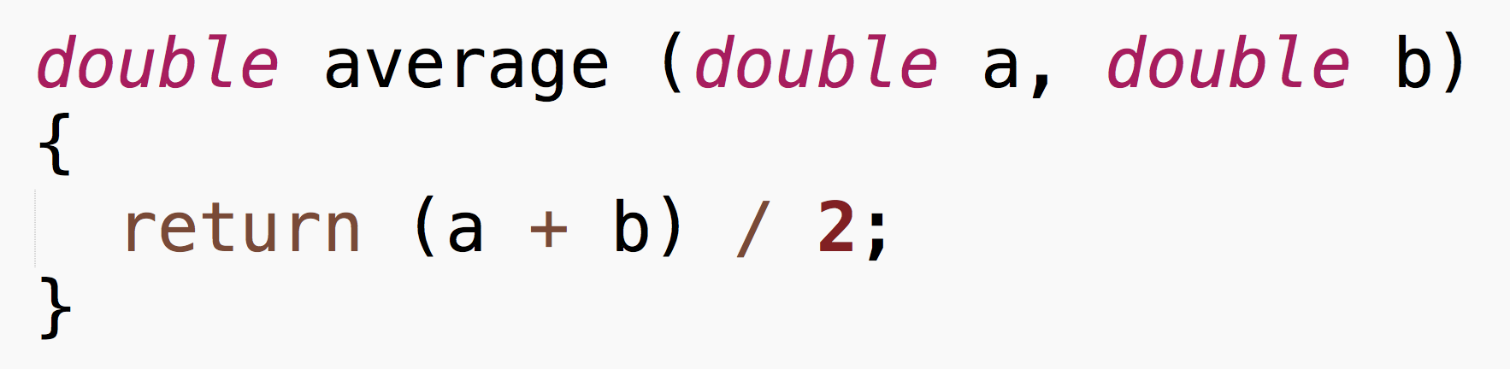
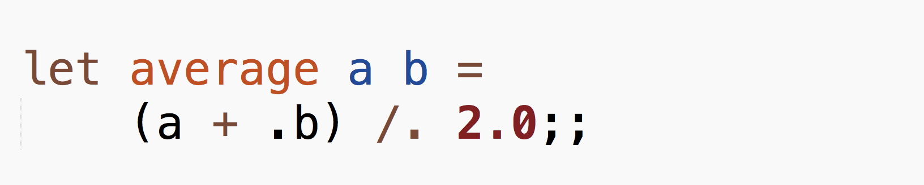

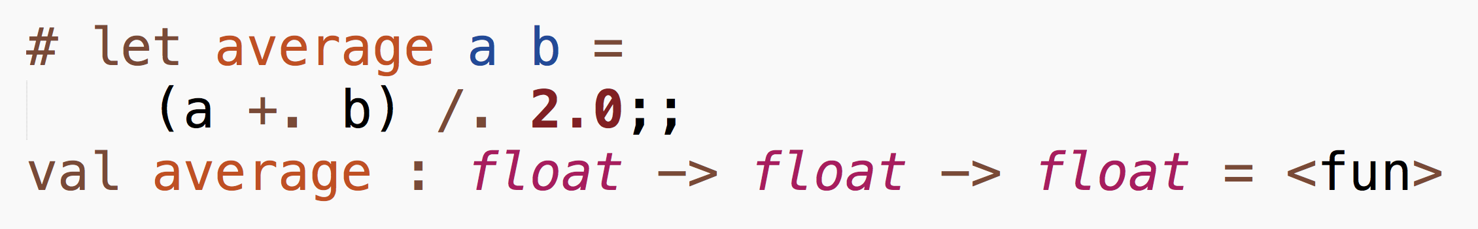
Compiler Errors Using Type Annotation
Jiani Huang, Soomin Lee, Yijun Zhang
UCSD CSE Early Research Scholars Program (ERSP)
Problem Statement
Data Analysis
Methods
Results
It is well-known in community that functional programming languages are challenging, but less is understood about why. Our goal is to understand how beginners learn OCaml and improve compiler error messages for type errors to make their learning process more efficient
Initial data analysis was done to see how much time the students spend on each homework problem to find out which concepts they struggle with the most.
After looking at type errors, in order to see how the student’s code changes over time, we tracked the progress of each function, and labeled them as bad/fix pairs:
From our dataset, we randomly picked 100 samples to check whether annotated code produces better error message or not.
Background
There are many many differences between object-oriented and functional programming languages (FP) that become bottlenecks for students learning the latter.
We proceeded to see if the actual fixed location matches the error location that compiler outputs and found that the error messages are often misleading.
1. More specific type:
Though error messages for both original and annotated code point to same location, the annotated version provided the user with more specific type, not the generic type which may be confusing to the programmer.
Time taken to complete a method vs. Percentage of students who completed the problem.
Students struggled with the first problem (blue) the most. Only 70% of students were able to compile it within a reasonable amount of time.
1. Types- Java vs. OCaml:
2. Type error for base case:
Types are explicitly declared in Java, but not in OCaml; all types are completely inferred
We decided to look at compiler errors which can be broken down into two different categories – type and syntax.
And from our collected data, we found out that type errors were the more challenging form of compiler output for beginners:
In order to improve error messages, we decided to use OCaml’s type annotation.
From top-level, typing an OCaml function generates its type annotation. It prints out what it thinks are the types of declared function. The general format is:
Because functional programming languages often use recursion, it is important to catch the type error in the base case.
2. Iteration vs. recursion:
3. Limitations:
Iteration(loops) in FP are usually achieved through recursion and high-order functions, where the functions can be passed in as arguments.
For library functions, such as List.fold, we were not able to improve the error message. Because we cannot add specific type annotation for them, compiler will always point to it regardless of where the actual type error is.
For example,
Data Collection
References
In order to track students’ progress, we collected data from homework assignments from CSE 130, which included snapshots of their entire file every thirty seconds. Collected as JSON files, they included the following:
Unix timestamp
Body of file
Section of code that was send to compiler
Output error message, if any
Tutorials & FAQ Retrieved from ocaml.org
And we used this information to annotate each function and its fixed version, to see if this would lead to OCaml compiler outputting more accurate error location:
Acknowledgements
So our goal is to help students minimize type errors.
We would like to thank
This material is based upon work supported by the National Science Foundation under Grant No. CNS-1339335.

